Slide 1
ASD-S Assessment Results 2020-21
Anglophone Sector

Slide 2
Contents
Early Years Evaluation
English Reading
French Reading
French Oral Proficiency

Slide 3
Pre-school screener EYE-DA Assessment

Slide 4
EYE-DA assesses five developmental areas associated with readiness to learn at school:
Developmental Area | Examples of child’s ability in each developmental area:
Awareness of Self & Environment | notice, think and talk about their world (e.g., identify: opposites, characteristics of common animals, colours, …) understand and use home and community experiences (e.g., A police officer keeps you safe)
Cognitive Skills | name letters and sounds recognize rhyme name numbers and count sets of objects recognize same and different
Language and Communication | listen and understand instructions, discussions, and stories use full sentences (i.e., five to seven words) to explain their ideas talk so people can easily understand
Fine Motor Skills | use crayons and pencils, cut, and handle small objects (e.g., sort and rearrange pebbles)
Gross Motor Skills | balance, hop on one foot, and jump
Notes:
EYE-DA = Early Years Evaluation-Direct Assessment
This screener is administered the fall prior to Kindergarten entry to identify children who have delays in any of the domains. This provides time for interventions and planning before children begin school.

Slide 5
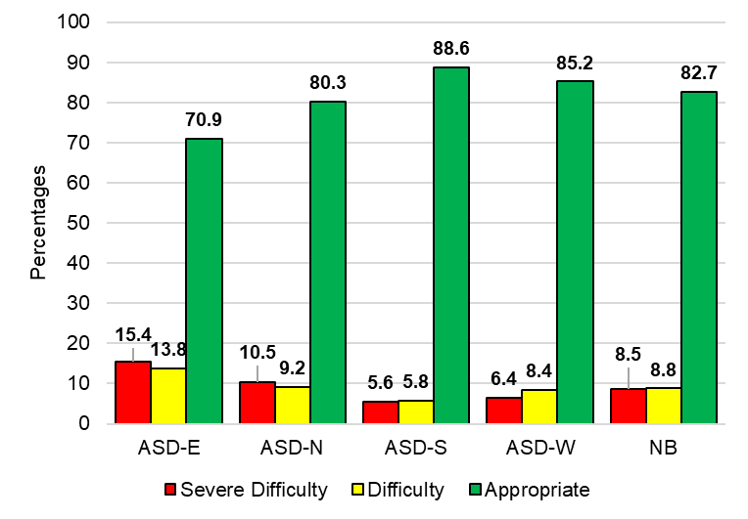
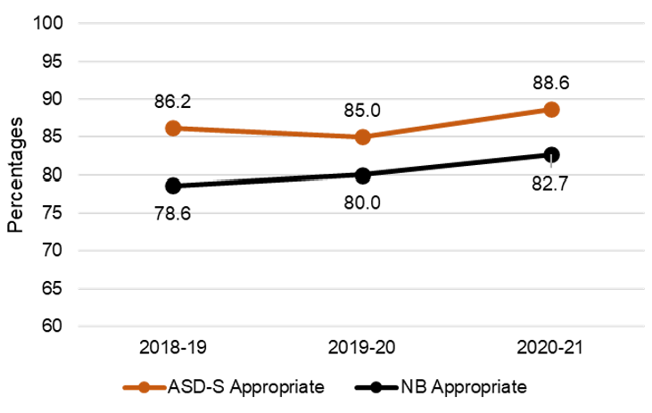
EYE-DA: Results for Awareness of Self and Environment
District and Province, for 2020-21
ASD-S and Province Trend

Slide 6
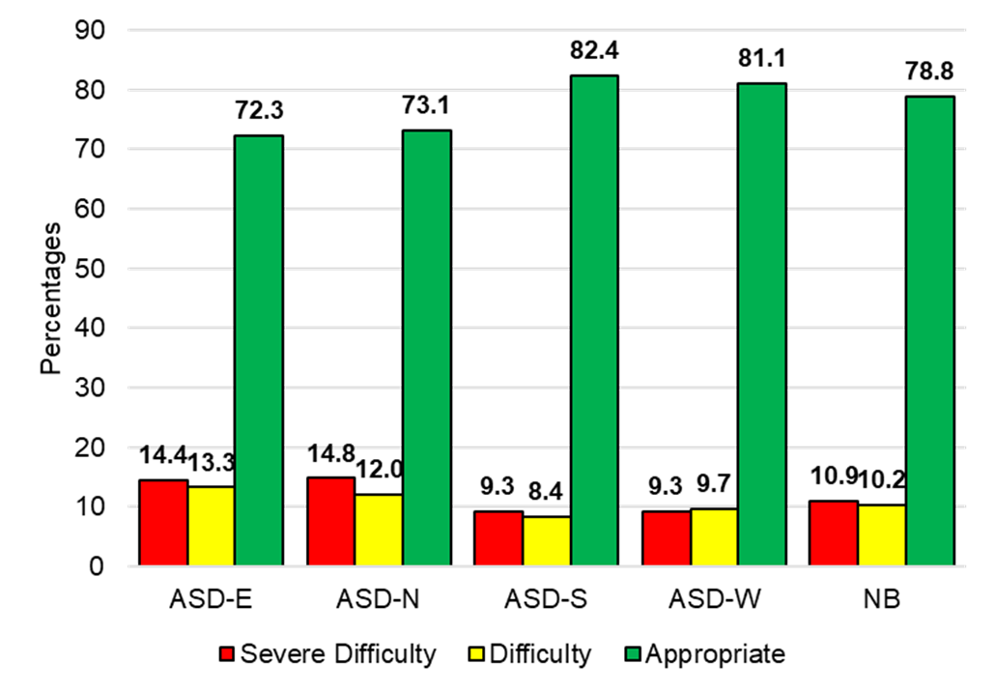
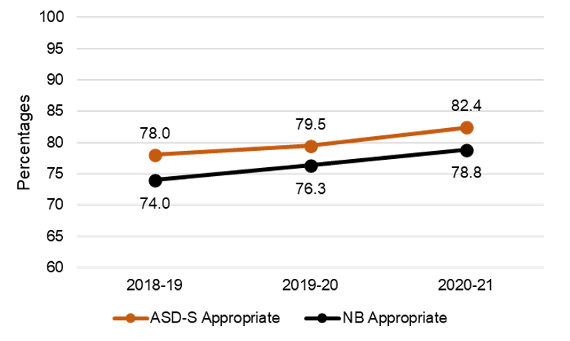
EYE-DA: Results for Cognitive Abilities
District and Province, for 2020-21
ASD-S and Province Trend

Slide 7
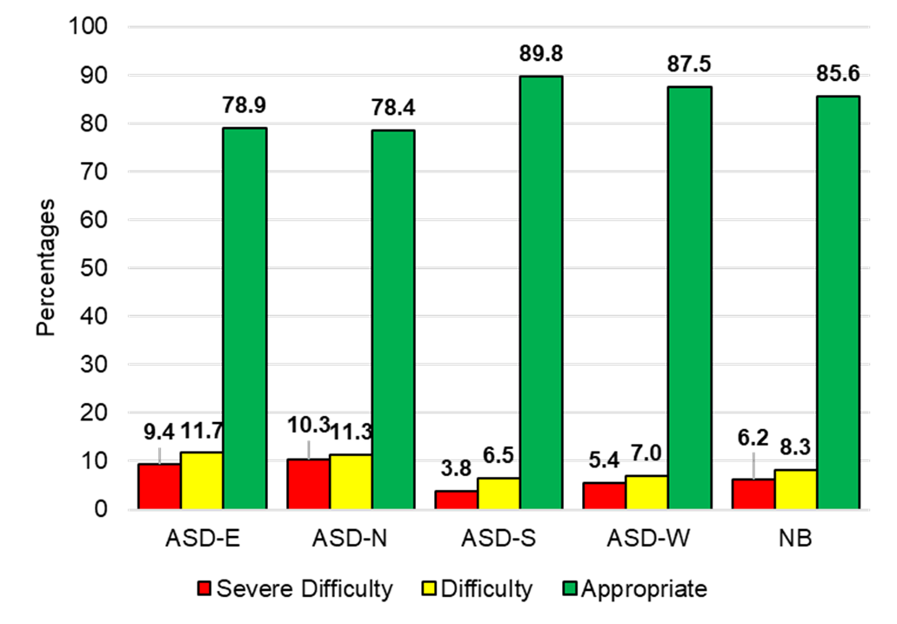
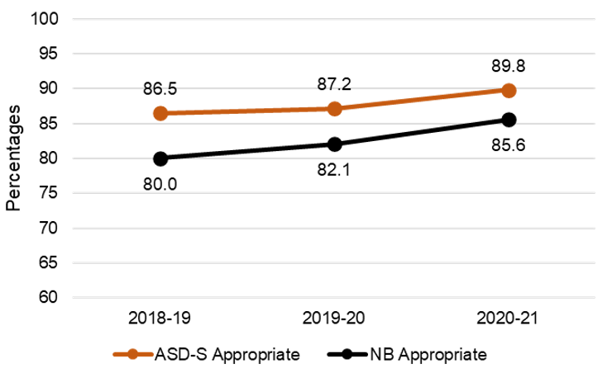
EYE-DA: Results for Language and Communications
District and Province, for 2020-21
ASD-S and Province Trend

Slide 8
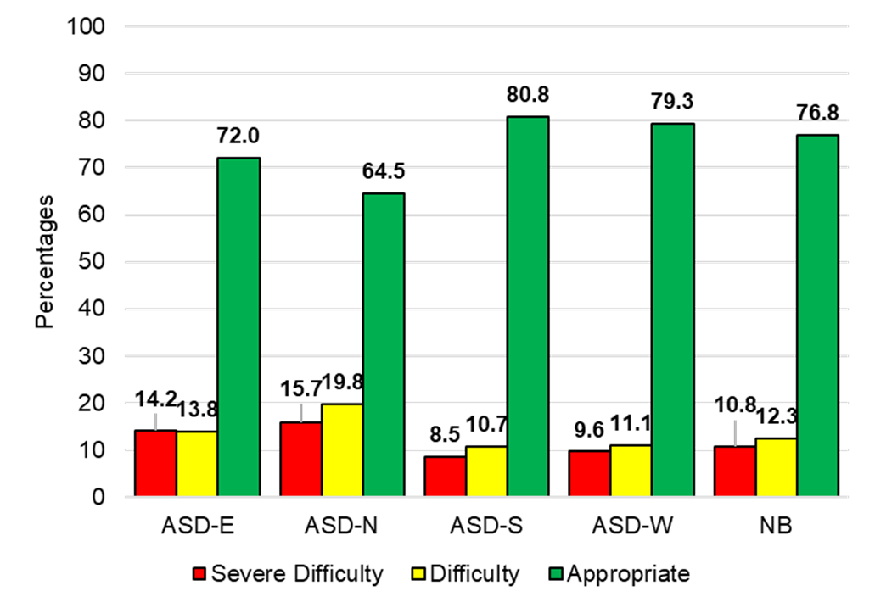
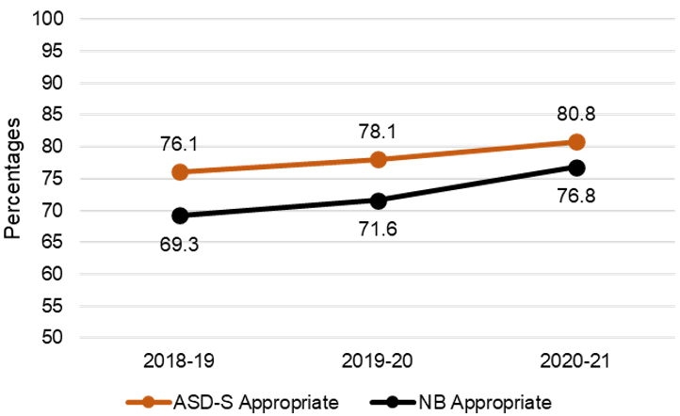
EYE-DA: Results for Fine Motor Skills
District and Province, for 2020-21
ASD-S and Province Trend

Slide 9
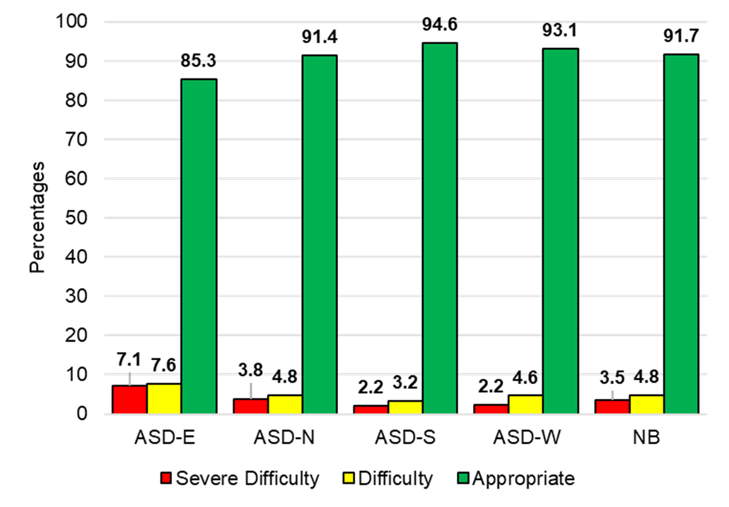
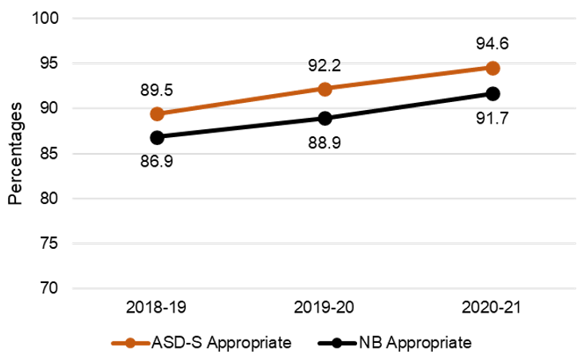
EYE-DA: Results for Gross Motor Skills
District and Province, for 2020-21
ASD-S and Province Trend

Slide 10
Assessment Program Updates
2017-18 Alignment with Francophone reporting methodology:
(1) transition to item response theory (IRT) statistical analysis begun
(2) discontinued practice of counting students who missed the assessment as Below Appropriate Achievement (percent exempted still counts as Below)
2018-19 Transition to IRT continued
2019-20 COVID - Only ELPA and Grade 12 French oral proficiency administered; transition to IRT complete
2020-21 COVID - Only English and French Second Language administered; transition to census administration begun (vs. matrix sample where students complete only ¼ of the assessment items)

Slide 11
Move to Census Assessment
Why?
Results are more precise
Produces classroom-level data that is more relevant for teachers and addresses equity across classrooms
Student-level results enable longitudinal research, tracking student cohorts, and subpopulations
Permits more detailed analyses of results to provide feedback for teachers, schools, and districts
Allows students see the results of their efforts
Notes:
With matrix sample, results also take longer to prepare and report because analytics must be produced for four datasets and comparisons made to ensure the four test versions are comparable.

Slide 12
2020-21 Results: Interpretation
Changes in administration or analysis generally require establishment of a new baseline.
This affects comparability of results to previous years.
Notes:
Standard setting takes into account:
Educator judgement (i.e., predictions of success based on their experience with the subject matter and grade level)
Established cut points for success (55%) and strong performance (85%)
Test characteristics indicating test difficulty, test effectiveness for discriminating between high and low performing students, and likelihood of correct responses attributable to chance.
(Strategic changes to the assessment program will be complete once the new assessments announced this year have been piloted and implemented (results available for publication in 2022-23)

Slide 13
2020-21 Results: Interpretation
ELPA, Grade 10 and 12 French Oral Proficiency Interview (OPI):
The 2020-21 results are precisely comparable to 2019-2020.
Grade 4, 6, and 10 English and French reading:
Comparison of student achievement is based on comparison of test items repeated from last year
Notes:
(Strategic changes to the assessment program will be complete once the new assessments announced this year have been piloted and implemented (results available for publication in 2022-23)

Slide 14
2020-21 Results: Participation
No significant difference in participation; less than one percentage point decrease in participation in nearly all assessments
Notable exceptions:
Grade 10 Reading - PIF:
21% of students expected to participate did not, compared to 15% last year
Grade 10 OPI - PIF:
Only 51% of students expected to participate did

Slide 15
2020-21 Results: Impact of COVID
Based on comparison of assessment items repeated from last year, this year’s cohorts performed slightly less well, on average, on nearly all assessments
BUT
The greatest declines were less than four percentage points on any assessment.
No losses evident for Grade 4 French Immersion Reading and Grade 10 French Immersion Reading.
No decline in French oral proficiency
Reminder: Impact on math and science is not known since these were not assessed
Notes:
REMINDER: We are not able to assess impact on numeracy and scientific literacy since assessments did not take place in these subjects due to pandemic-related circumstances.
REMINDER: Although this conclusion can be drawn from analysis of student performance on repeated test items, assessment results, aside from the ELPA and OPIs, are not comparable between the two years due to the change from matrix sampling to census administration.
This change necessitated an independent standard-setting process as would be done for any new assessment.
Next year’s results for Grade 4 & 6 English Reading, ELPA and PIF/FI Reading will be equated/comparable with this year’s.

Slide 16
English reading

Slide 17
Grade 4, 6 and 9: English Reading % Successful by District and Grade level
Notes:
Reminder: % Successful = % Appropriate + % Strong

Slide 18
French Second Language

Slide 19
French Second Language Reading Assessment % Successful by District by Grade level
Note: Grade 6 and 10 students writing these assessments began FI in Grade 3. Grade 4 students writing these assessments began FI in Grade 1.
Notes:
FI = French Immersion

Slide 20
French Second Language Reading Assessment % Successful by District by Grade level
Note: All students writing these assessments began FI in Grade 6.
Notes:
Note: the FI Reading assessment is the same for Early and Late FI students but the threshold for “success” is adjusted for fairness.
Post-Intensive French students are provided with a different reading assessment.

Slide 21
French Second Language Reading Assessment % Successful by District by Grade level
Note: All students writing these assessments participated in the Grade 5 Intensive French Program.

Slide 22
NB Second Language Oral Proficiency Scale Performance Description for Intermediate Level
The student is able to satisfy routine social demands and limited requirements in school/work settings with a speaking vocabulary sufficient for simple conversation, with some paraphrasing.
The student can:
provide information and give explanations with some degree of accuracy;
handle most common social situations, including introductions and casual conversations about events in school and community;
provide autobiographical information in some detail;
give directions from one place to another; and
give accurate instructions in a field of personal expertise.
Notes:
We have chosen the “Intermediate” level of proficiency for comparing the success of the three FSL programs offered in NB. This level can be considered “conversational French”.

Slide 23
French Second Language Oral Proficiency % Intermediate and Above by District by Grade level – all Programs
Note: the Grade 6 assessment was administered in 2018-19
Notes:
Administration of the Grade 6 and 10 Oral Proficiency Assessments alternate, so the Grade 10 results are from the 2017-18 year. They are included in the presentation to provide a more complete picture of FSL results.

Slide 24
Grade 12 French Second Language Oral Proficiency over time by Program % Intermediate and Above

Slide 25
Grade 12 French Second Language Oral Proficiency
All students assessed in Grade 12 began FI in Grade 1
Notes:
Note: In 2014-2015 school year, participation was mandatory for Grade 12 Early and Late entry French Immersion students but not for PIF.
French Immersion students, both early and late entry are defined as those who adhere to Policy 309. Students must have taken 25% of courses in French in Grade 11 and/or Grade 12.
In Year 2015-16, participation was mandatory for Grade 12 all three programs.
Reason being we have exhibited the data for PIF beginning 2015-16

Slide 26
Grade 12 French Second Language Oral Proficiency Post Intensive French - % attaining Intermediate and Above
Notes:
Promising results for the IF/PIF program. Results have improved in all districts.

